Slide 1
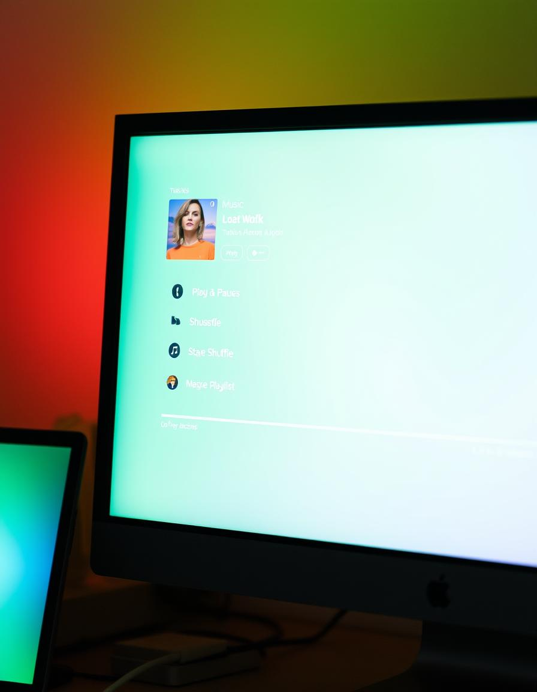
Creating a Music Playlist with HTML and CSS
By – Vanshika Sisodiya,Pari Bagrecha, Devanginee Sen

Slide 2
Building a music playlist using HTML and CSS provides a foundation for creating interactive and personalized music experiences. By understanding the basic structure and styling, we can craft captivating and user-friendly interfaces for our music collections.

Slide 3
Importance of a Customized Music Experience
Personalised selection | Mood Enhancement | Discovery and Exploration
A tailored playlist allows users to create a soundtrack that resonates with their tastes,creating a unique and satisfying listening experience. | Music plays a significant role in setting the tone and influencing emotions,offering a personalized soundtrack for various moods and activities. | Custom playlists can introduce users to new artists and genres,expanding their musical horizons and fostering a love for diverse sounds.

Slide 4
HTML Structure for Playlist Layout
Unordered List (UL)
The <ul> element is used to create a list of songs, with each song being an <li> item.
List Items (LI)
Each <li> element represents a single song in the playlist and can include the song title, artist, and other metadata.
Div Containers
Use <div> elements to structure and group elements like the playlist controls or a song information section.

Slide 5
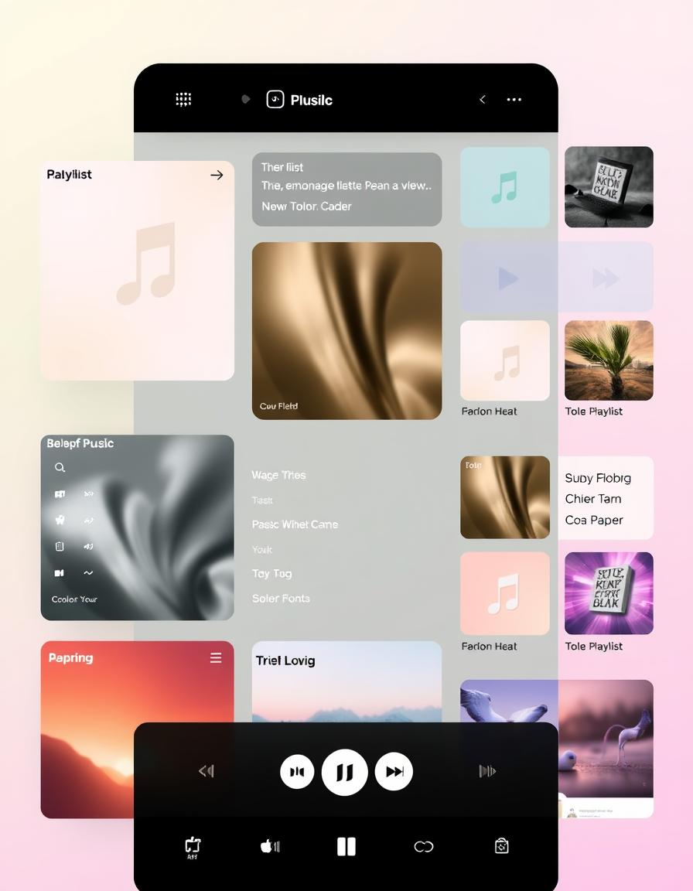
Styling the Playlist with CSS
Font Styles Choosing appropriate font families and sizes enhances readability and creates a visual hierarchy, guiding the user's attention to key information. | Color Schemes Select colors that complement each other and create a pleasing visual experience. Use contrasting colors for text and background.
Layout Determine the layout of the playlist, using CSS properties like "display," "flex," or "grid" to arrange the elements effectively.

Slide 6
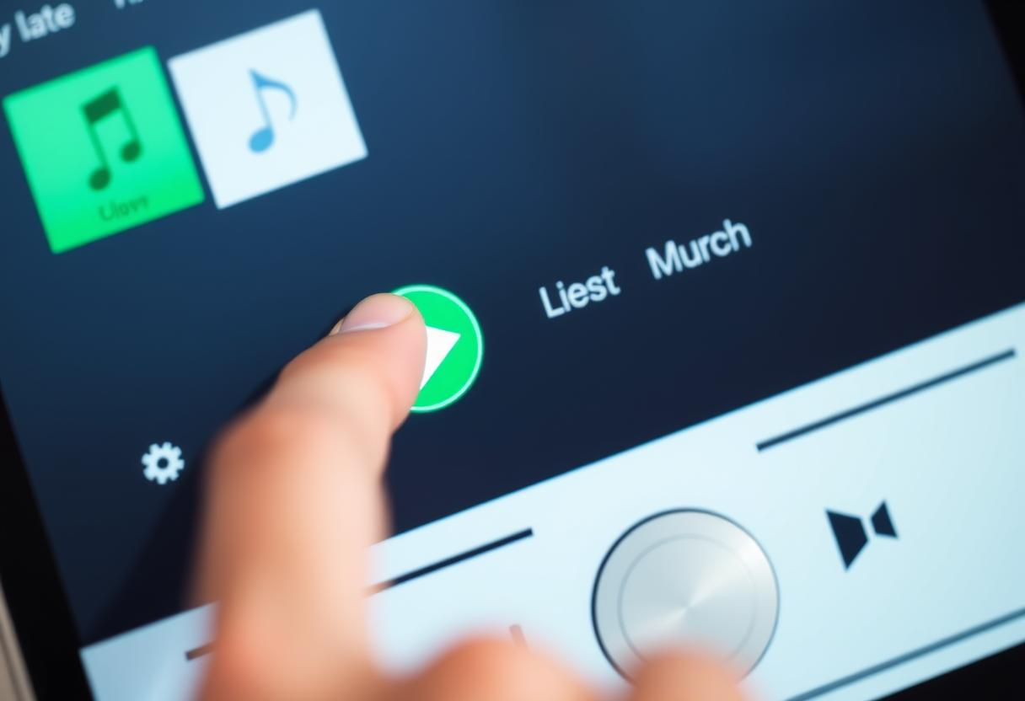
Adding Interactivity with JavaScript
1. Play/Pause Implement functionality to play and pause music using JavaScript event listeners and audio controls. | 2. Song Selection Allow users to select different songs from the playlist by clicking or tapping on list items. | 3. Volume Control Add a slider or buttons to control the volume of the music, allowing users to adjust the audio level.

Slide 7
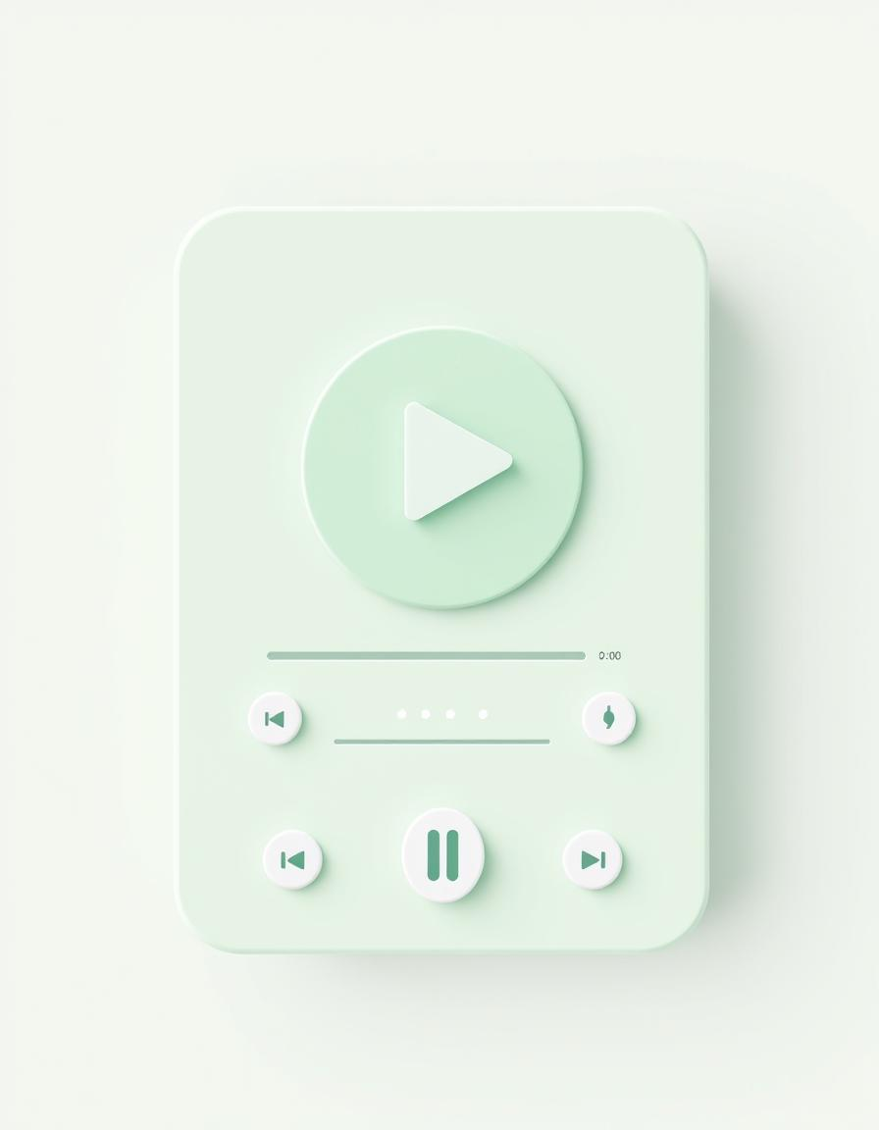
Conclusion and Next Steps
☆
Advanced Features
Explore advanced features like repeat, and custom playlists.
♫
Customization
Customize the appearance and functionality of your playlist to meet your specific needs and preferences.

Slide 8
